Slide 1
Employee Retention Prediction

Slide 2
Agenda
Problem Statement
Dataset Overview
Data Cleaning
Exploratory Data Analysis (EDA)
Model Building
Model Evaluation
Deployment
Conclusion

Slide 3
Problem Statement
Employee Attrition is a major challenge for oraganizations
High Attrition leads to:
Increased hiring cost
Loss of talent
Objective:
Predict whether an employee will stay or leave.

Slide 4
Objective
Build a machine learning Model
Identify key factors affecting retention
Deploy model using Streamlit

Slide 5
DataSet Overview
Source: ERP Data (ERP 1 & ERP 01)
Target Variable:
0 - Stay
1 – Leave
Key Features:
City Development Index
Training Hours
Experience
Last Job Gap

Slide 6
Data Cleaning
Removed null values
Fixed data types
Removed unwanted columns(IDs, Duplicates)
Combined ERP datasets
Handled missing values

Slide 7
Feature Engineering
Selected important features
Encoded categorical variables
Scaled numerical features
Balanced dataset using SMOTE

Slide 8
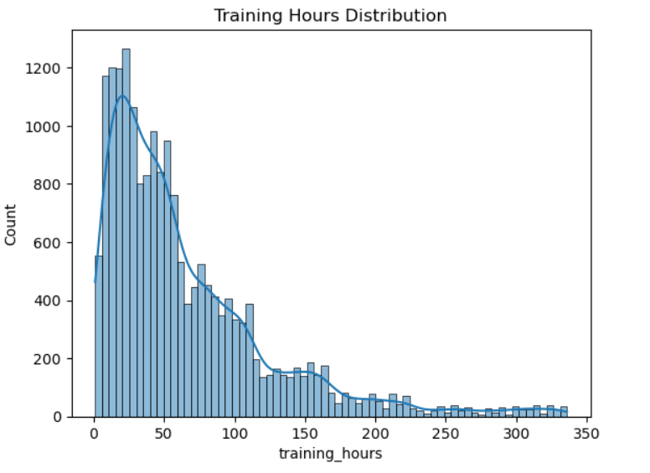
EDA – Distribution of Training Hours
Distribution (Histogram)
Explanation:
Most employees have low training hours
Low training – Higher chance of leaving
Very few employees high training hours, indicating
Limited skill development
Training distribution is skewed towards the lower
Side, suggesting a gap in lower opportunities.

Slide 9
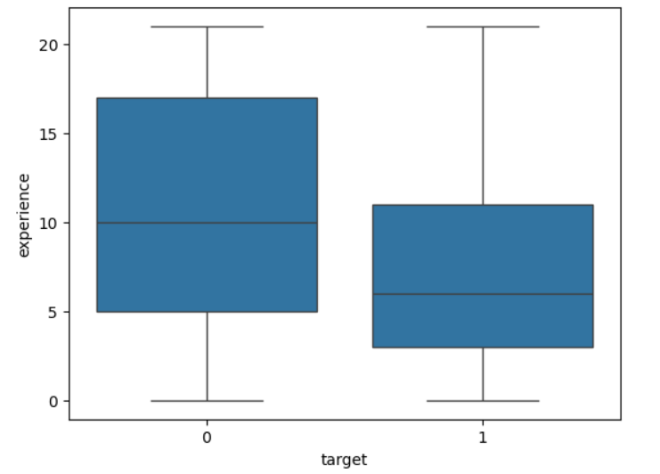
EDA - Training vs Target
EDA (BOX PLOT)
Explanation:
Employees with low experience leave more
High experience employee are more stable
Early - career employees are more likely to switch jobs
Attrition rate decreases as experience increases
This indicates that remaining early-stage employees
Is critical for reducing overall attrition.

Slide 10
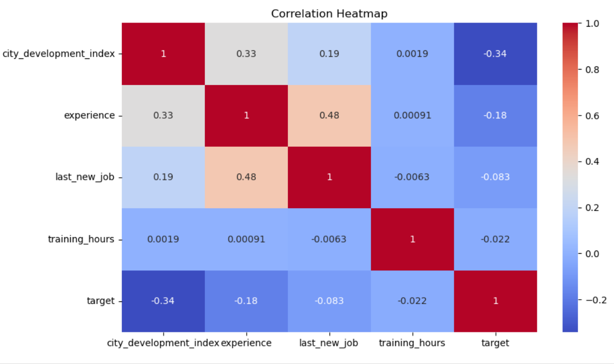
EDA - Correlation Analysis
EDA - HEATMAP
Explanation:
Training hours negstively correlated with attrition
Experience reduces attrition risk
Key features like training hours and experience play
A significant role in predicting employee retention
Improving training programs and retaining experienced
Employees can significantly reduce attrition rates.

Slide 11
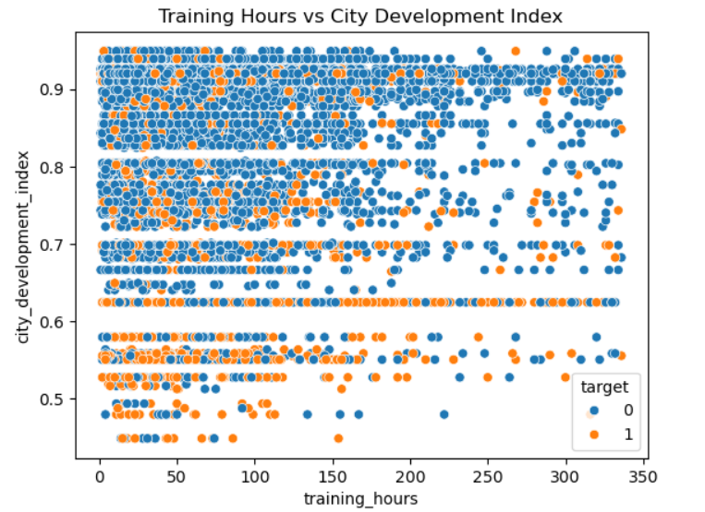
EDA - City Development vs Training
EDA – SCATTER PLOT
Explanation:
Employees in low development areas tend to leave more
High development index better retention
Limited access to resources and learning environments
May contribute to higher attrition in these regions
Enhancing training programs in less developed areas
Can help reduce attrition
And improve employee retention

Slide 12
Model Building
Models used:
Logistic Regression
Random Forest
XGBoost
LightGBM

Slide 13
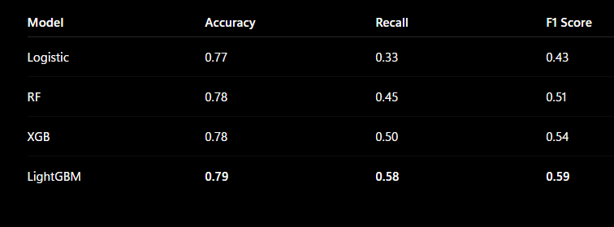
Model Evaluation

Slide 14
Final Model
Selected Model: Random Forest
Provides stable and reliable performance
Across different datasets
Handles both numerical and categorical
Features effectively
Performs well without extensive parameter tuning
Random Forest was selected as the final model due to its robustness, Consistency and ease of interpretation

Slide 15
Deployment
Deployed using streamlit
Build interactive UI
User inputs employee details
Model predicts retention

Slide 16
Key Insights
Low experience - higher attrition
Low training hours - higher attrition
Frequent job change - high risk
Development index impact retention

Slide 17
Conclusion
Build predictive model successfully
Identify key retention factors
Created deployable ML application

Slide 18
Thank You!

